Slide 1
Using video-oriented instructions to speed-up sequence comparison
Wozniak’s article

Slide 2
Introduction

Slide 3
Introduction (1)
Aims :
Compare the performances of the same algorithm between integer instruction and specialized video-oriented instructions
See how parallelization can be done to speed-up the algorithm

Slide 4
Introduction (2)
Why ?
Ameliorate and find solutions for data-bank scanning
Specialized hardware solutions have some disadvantages (high cost, difficul programming or debugging…)
Reduce time execution : program spends 99% of the time in Smith-Waterman algorithm procedure

Slide 5
Summary
Smith-Waterman algorithm
Parallelization with vectors
Parallelization with video-oriented instructions
Benchmarks
Conclusion

Slide 6
Smith-Waterman algorithm

Slide 7
Local alignment (1)
0
F(i-1,j-1) + s(xi,yj) : (mis)match
F(i,j) = max F(i-1,j) + s(xi,-) : deletion
F(i,j-1) + s(-,yj) : insertion
F : score-matrix
s(xi,yj) : substitution-matrix (gap-scoring)
s(xi,-) and s(-,yj) = d or e
d : penalty for opening a gap (d<0)
e : penalty for extending a gap (d/2 < e < 0)
F(i,0) = F(0,j) = 0

Slide 8
Local alignment (2)
Two steps :
Compute the score (cost of transformation of the first sequence to the second)
Backtracing to construct the desired alignment

Slide 9
Example of substitution matrices (1)
For nucleic sequences :
BLAST transition-transversion
For proteic sequences :
BLOSUM62 (see next page)
 | A | T | G | C
A | 1 | -3 | -3 | -3
T | -3 | 1 | -3 | -3
G | -3 | -3 | 1 | -3
C | -3 | -3 | -3 | 1
 | A | T | G | C
A | 3 | 0 | 1 | 0
T | 0 | 3 | 0 | 1
G | 1 | 0 | 3 | 0
C | 0 | 1 | 0 | 3

Slide 10
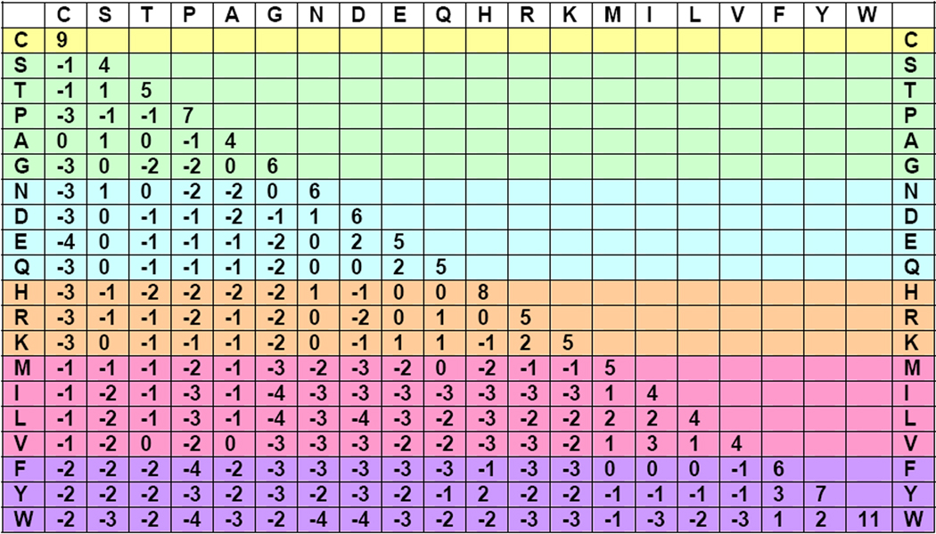
Example of substitution matrices (2)
BLOSSUM

Slide 11
Smith-Waterman affine scoring algorithm (1)
Basic algorithm :
int nogap[MAX_A] , b_gap[MAX_A] ;
int sw(char *seqA, int lena, char *seqB, int lenb,
int gap_open, int gap_ext, SCORING_MATRIX_TYPE matrix)
{ int i , j ;
int last_nogap, prev_nogap;
int score = 0;
init_vect(lena, nogap, 0);
init_vect(lena, b_gap, - gap.open);
(suite next page)

Slide 12
Smith-Waterman affine scoring algorithm (2)
for (i=0; i<lenb; ++i) {
int a_gap;
last_nogap = prev_nogap = 0;
a_gap = - gap_open;
for (j=0; j<lena; ++j) {
a_gap = MAX((last_nogap – gap_open – gap_ext),
(a_gap – gap_ext));
b_gap[j] = MAX((nogap[j] – gap_open – gap_ext),
(b_gap[j] – gap_ext));
last_nogap = MAX((prev_nogap + matrix[seqA[j]][seqB[i]]) , 0);
last_nogap = MAX(last_nogap, a_gap);
last_nogap = MAX(last_nogap, b_gap[j]);
prev_nogap = nogap[j];
nogap[j] = last_nogap;
score = MAX(score, last_nogap); }}
return score;
}

Slide 13
Smith-Waterman affine scoring algorithm (3)
Notations used in the program :
matrix ~ s
gap_open ~ d, gap_ext ~ e
no_gap ~ match or mismatch
a_gap ~ s(xi,-) on seqA
b_gap ~ s(-,jy) on seqB
last_nogap ~ F(i,j) in each loop (max of 4 arguments)

Slide 14
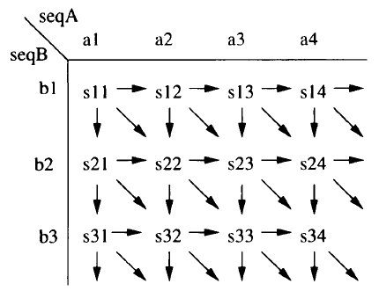
Dependences
Horizontal, vertical and diagonal dependences :

Slide 15
Parallelization with vectors

Slide 16
Brief
Why ?
Growth of data-banks => hours/weeks to compute
only on one computer
How ?
Multiprocessors
Clusters of workstations (computers)
Two kinds of parallelization :
Sequence-to-bank <-- inter and intra bank
Sequence-to-sequence

Slide 17
Basic SW (Smith-Waterman) algorithm
Limited in pure databank scanning
Need to use the dependences to modify its structure to make a parallelized algorithm

Slide 18
Idea (1)
Execute two rows in parallel :
Transform the inner loop in a loop doing consecutives steps j and j+1 : these two steps can be done independantly => rows 1 and 2 can be executed in parallel
Compute no_gap and b_gap after the two steps
Be careful about the lenght of seqB : cases lenB even or odd => add dummy symbol
symbole factice

Slide 19
Idea (2)
Execute four rows in parallel :
Transform the inner loop in a loop doing consecutives steps j, j+1, j+2, j+3 : these four steps can be done independantly => rows 1, 2, 3 and 4 can be executed in parallel
Compute no_gap and b_gap after the four steps
Be careful about the lenght of seqB :
cases lenB = 0, 1, 2, 3 [4] => add 3 dummy symbols

Slide 20
Parallelized SW (1)
Parallelized SW affine-scoring algorithm :
int nogap[MAX_A], b_gap[MAX_A];
int Vectsw(char *seqA, int lena, char *seqB,
int lenb, int gap_open, int gap_ext,
SCORING_MATRIX_TYPE matrix)
int i, j, score;
Vint4 Vscore = { 0, 0, 0, 0 };
Vint4 Vzero = { 0, 0, 0, 0 };
Vint4 Vgap_ext = { gap_ext, gap_ext,
gap_ext, gap_ext };
Vint4 Vgap_open = { gap_open, gap_open,
gap_open, gap_open };
(suite next page)

Slide 21
Parallelized SW (2)
init_vect(lena+6, nogap, 0);
init_vect(lena+6, b_gap, - gap_open);
for (i=0; i<lenb+3; i+=4) {
Vint4 Vmatrix;
Vint4 Va_gap = - Vgap_open;
Vint4 Vb_gap = { b_gap[2] , b_gap[1], b_gap[0], 0};
Vint4 Vnogap = { nogap[2], nogap[1], nogap[0], 0};
Vint4 Vlast_nogap = Vzero;
Vint4 Vprev_nogap = Vzero;
(suite next page)

Slide 22
Parallelized SW (3)
for (j=0; j<lena+3; ++j) {
Va_gap = VMAX((Vlast_nogap – Vgap_open –
Vgap_ext), (Va_gap – Vgap_ext));
Vb_gap = VMAX((Vnogap – Vgap_open – Vgap_ext),
(Vb_gap – Vgap_ext));
Vmatrix = { matrix[seqA [j+3]][seqB[i]],
matrix[seqA [j+2]][seqB[i+1]],
matrix[seqA [j+1]][seqB[i+2]],
matrix[seqA [j]][seqB[i+3]] };
(suite next page)
Vb_gap = VSHIFT(Vb_gap, b_gap[j+3]);
Vnogap = VSHIFT(Vnogap, nogap[j+3]);
overhead

Slide 23
Parallelized SW (4)
Vlast_nogap = VMAX((Vprev_nogap + Vmatrix),
Vzero);
Vlast_nogap = VMAX(Vlast_nogap, Va_gap);
Vlast_nogap = VMAX(Vlast_nogap, Vb_gap);
Vprev_nogap = Vnogap;
Vnogap = Vlast_nogap;
b_gap [j] = Vb_gap.v[3];
nogap [j] = Vnogap.v[3];
Vscore = VMAX(Vscore, Vlast_nogap); } }
return max(Vscore.v[0], Vscore.v[1],
Vscore.v[2], Vscore.v[3]);
}

Slide 24
Operators
VMAX : computes the maximum vector of two vectors
VSHIFT : shifts left all its components and puts right second argument
‘+’ and ‘-’ : add and substract operators on vectors

Slide 25
Performances ?
Not so many improvements than for basic SW !
Reasons ?
probably communications
That’s too bad !
But we do not say our last word !

Slide 26
Parallelization with video-oriented instructions

Slide 27
Video-oriented instructions
VIS (Visual Instruction Set) :
SIMD instruction set extension for SPARC processors
VIS instructions :
executed in FPU (Floating Point Unit), part of a processor doing operations on floating point numbers
uses 64-bit registers of the FPU
FPU :
Two integers of 32 bits
Four integers of 16 bits

Slide 28
Modifications
We take the previous program and modify :
Types of variables as Vint4
Operators VMAX, VSHIFT, ‘+’, ‘-’
vis_d64 : vector of four 16-bit integers
(VIS_MAX_INT is define next page)
Vectors | Vint4 | VMAX | VSHIFT
Video-oriented | vis_d64 | VIS_MAX_INT | vis_faligndata
Vectors | ‘+’ | ‘-’
Video-oriented | vis_fpadd16 | vis_fpsub16

Slide 29
Max operation using VIS
#define VIS_MAX_INT(aa, bb) \
{\
vis_d64 mm;\
aa = vis_fpsub16(aa, bb);\
mm = vis_fand(aa,
fmask_0x8000800080008000);\
mm =
vis_fmul8ulx16(fmask_0x0002000200020002,
mm);\
aa = vis_fandnot(mm, aa);
aa = vis_fpadd16(aa, bb);\
}
(we will come back to this later)

Slide 30
Analysis
We also execute 4 rows in parallel
(not really, see next page)
ULTRA SPARC VIS instructions computes a mask of 4 bits of result (1 if we store the word of 16-bits, 0 else)
Problem :
Many comparisons re-use intermediate results so there are communications to reload store values

Slide 31
Processor ULTRA SPARC
Graphic processor is a double-issue engine, fully pipelined
Treat eight (2*4) instructions in desorder (little endian)
Latency of 3 clock cycles for multiplication
32 registers of 64 bits sufficient to keep all the computations local

Slide 32
Solutions of LASSAP
Avoid branch instructions, using the computation done with MAX_INT_NO_JUMP next page (be careful about overflow)
Modify it for use it with VIS
Treat 8 rows so multiplications done (taking 3 clock cycles) are started in following cycles
Conclusion : CPU keeps busy for maximal performance and GPU treat in parallel 8 rows

Slide 33
Max operation with no branch instruction
#define MAX_INT_NO_JUMP(int_max, int_val)\
{\
int mask;\
int_max -= int_val;\
/* no overflow allowed here ! */ \
mask = (int_max>>(8*sizeof(int_max)-1)) ;\
/* -1 if negative, 0 otherwise */ \
int_max & int_max + (int_val); ~mask; \
}

Slide 34
Max operation using VIS
#define VIS_MAX_INT(aa, bb) \
{\
vis_d64 mm;\
aa = vis_fpsub16(aa, bb);\
mm = vis_fand(aa,
fmask_0x8000800080008000);\
mm =
vis_fmul8ulx16(fmask_0x0002000200020002,
mm);\
aa = vis_fandnot(mm, aa);
aa = vis_fpadd16(aa, bb);\
}

Slide 35
Comments on computations
Inner loop executed (lena+7)/8 times (because 7 dummy symbols)
Types of variables used are sufficient to compare proteic and nucleic sequences
Score of 32 767 (saturation) ~ perfect alignment of lengh 5 000 (with BLOSUM62 matrix)

Slide 36
Benchmarks

Slide 37
Experimentation
Comparison between integer SW algorithm (32 bits) and VIS SW algorithm (16 bits) for an ULTRA SPARC machine
Test on other machines
Conclusion : VIS SW algorithm twice as fast as integer SS algorithm
(see next page)

Slide 38
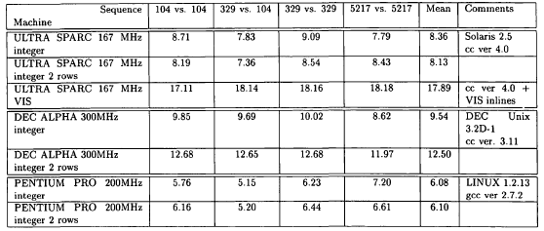
Execution speed in millions of matrix per second

Slide 39
Into LASSAP’s software package
We use now many processors
Same performance of each processors than previously
(see next page)

Slide 40
Real execution time
Real execution time versus number of processors in millions of matrix cells per second :
N | Real execution time | Global performance | Performance per processor
1 | 5’10’’ | 17.93 | 17.93
2 | 2’38’’ | 35.19 | 17.59
4 | 1’19’’ | 70.37 | 17.59
6 | 0’53’’ | 104.89 | 17.48
8 | 0’40’’ | 138.98 | 17.37
10 | 0’33’’ | 168.46 | 16.84
12 | 0’29’’ | 191.70 | 15.97

Slide 41
Conclusion

Slide 42
Conclusions on the results
When increasing number of processors :
global performance increases too, we notice that :
execution time decreases, we notice that :
with N = number of processors
global_performance(N) = N * performance_per_processor
execution_time(N) = execution_time(1) / N

Slide 43
Conclusion
VIS instructions give good performances for parallelization
This method can be extented to other types of algorithms parallelizable
This method can speed up performances of hardware using many processors, even those which already good in computations (as BIOACCELERATOR for example)

Slide 44
Bibliography
Article : Using video-oriented instructions to speed up sequence comparison, Wozniak
Sequence comparison algorithms :
http://ead.univ-angers.fr/~jaspard/Page2/BIOINFORMATIQUE/
7ModuleBioInfoJMGE/9AlgoProgramme/1ProgAlgo.htm
Substitution matrices :
http://ead.univ-angers.fr/~jaspard/Page2/BIOINFORMATIQUE/
7ModuleBioInfoJMGE/99Matrice/1Matrice.htm
Course of Laurent Noé
Wikipedia
THE END

